Slide 1
MAGNETISM
Physics Unit 10

Slide 2
This Slideshow was developed to accompany the textbook
  OpenStax Physics
    Available for free at https://openstaxcollege.org/textbooks/college-physics
  By OpenStax College and Rice University
  2013 edition
Some examples and diagrams are taken from the textbook.
Slides created by
Richard Wright, Andrews Academy
rwright@andrews.edu

Slide 3
10-01 Magnets
In this lesson you will…
• Describe the difference between the north and south poles of a magnet.
• Describe how magnetic poles interact with each other.
• Define ferromagnet.
• Describe the role of magnetic domains in magnetization.
• Explain the significance of the Curie temperature.
• Describe the relationship between electricity and magnetism.

Slide 4
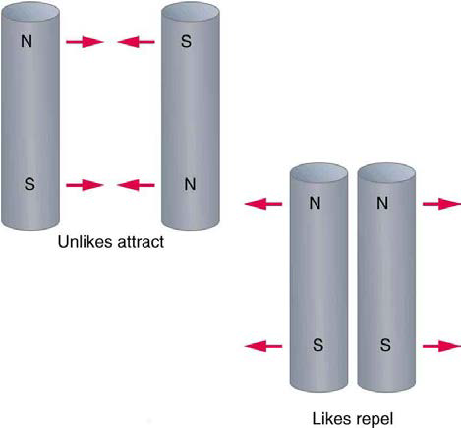
10-01 Magnets
Magnets have two ends called poles
  North and South poles
  There are no single poles
Like poles repel, Opposite poles attract

Slide 5
10-01 Magnets
Electromagnetism
  It was discovered that running current through a wire produced a magnet
  The magnetism around permanent magnets and currents are very similar, so both must have common cause.
  Current is the cause of all magnetism

Slide 6
10-01 Magnets
Ferromagnetism
  Magnetic materials have an unpaired outer electron.
  Atoms near each other line up so that the unpaired electrons spin the same direction.
  This spinning creates magnetism
Notes:
Metals beyond the first row of periodic table must loose their electrons too easily to be magnetized.

Slide 7
10-01 Magnets
Ferromagnetism
  In permanent magnet the current is electrons in atoms.
    Move around nucleus and spin
    Most cancels out except in ferromagnetic materials
  Ferromagnetic materials
    Electron magnetic effects don’t cancel over large groups of atoms.
    This gives small magnetic regions size of 0.01 to 0.1 mm called magnetic domains.
    In a permanent magnet, these domains are aligned.
  Common magnetic materials are iron, nickel, cobalt, and chromium dioxide.

Slide 8
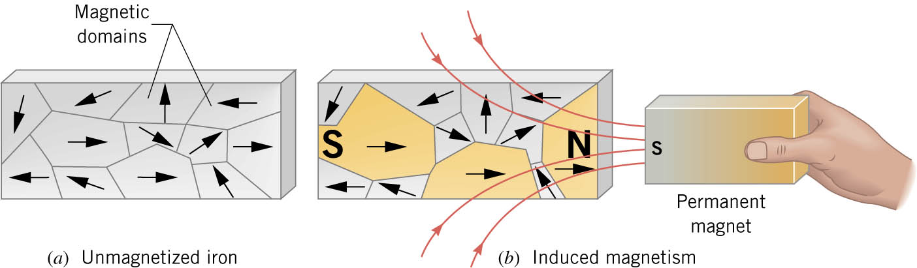
10-01 Magnets
Induced Magnetism
  Usually the magnetic domains are randomly arranged.
  When it is placed in a B-field, the domains that are aligned with the B-field grow larger and the orientation of other domains may rotate until they are aligned.
  This gives the material an overall magnetism.
Notes:
Dropping or banging a permanent magnet can disalign the magnetic domains and thus have a weaker B-field.
The induced B-field can be 1000’s of time larger than the field that induced it, so electromagnets have iron cores wrapped with wire.

Slide 9

10-01 Homework
This homework is attractive.
Read 22.1-22.5
There are no answers for me to post so here is an interesting picture caused by magnetism.

Slide 10
10-02 Magnetic Fields and Force on a Moving Charge
In this lesson you will…
• Define magnetic field and describe the magnetic field lines of various magnetic fields.
• Describe the effects of magnetic fields on moving charges.
• Use the right hand rule 1 to determine the velocity of a charge, the direction of the magnetic field, and the direction ofthe magnetic force on a moving charge.
• Calculate the magnetic force on a moving charge.
• Describe the effects of a magnetic field on a moving charge.
• Calculate the radius of curvature of the path of a charge that is moving in a magnetic field.

Slide 11
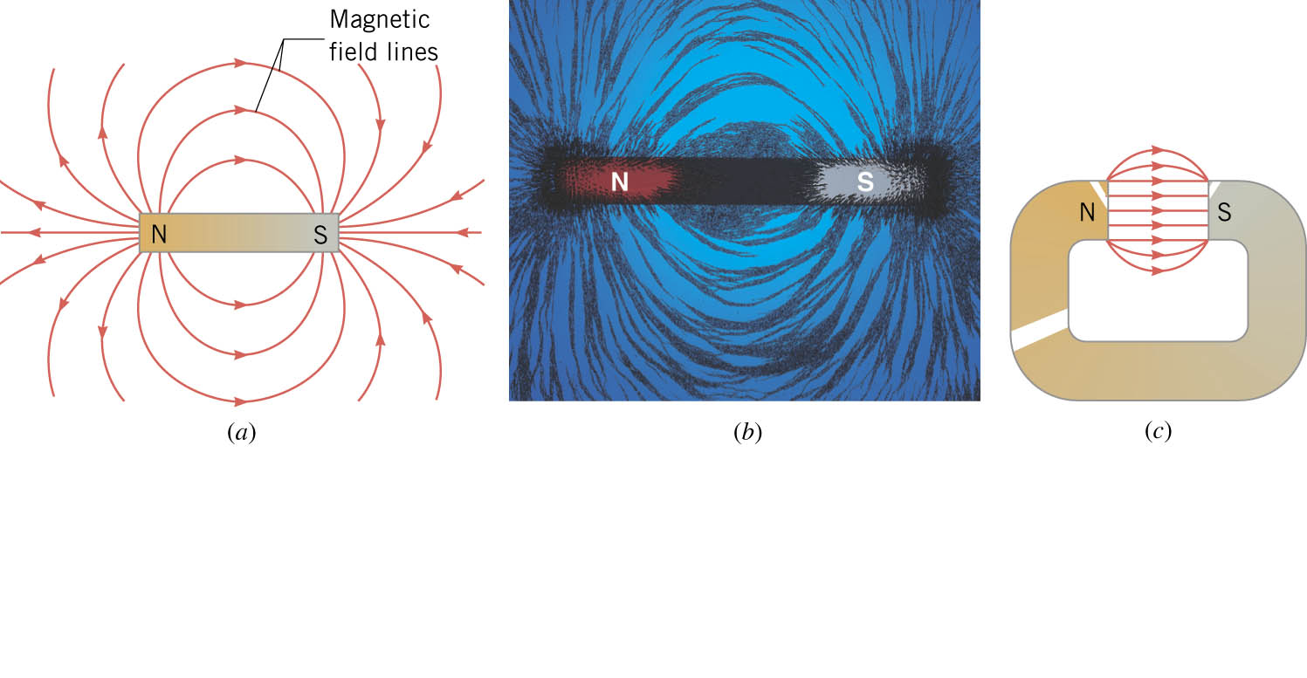
10-02 Magnetic Fields and Force on a Moving Charge
Around a magnet is a magnetic field (B-field)
  At every point in space there is a magnetic force
  Can be seen with a compass
  Unit is Tesla (T)
Magnetic fields can be visualized with field lines.
  Start at N pole and end at S pole
  The more lines in one area means stronger field
Notes:
Picture notes: a) Magnetic field lines; b) magnetic field lines made with iron filings; c) magnetic field lines – constant between poles.

Slide 12
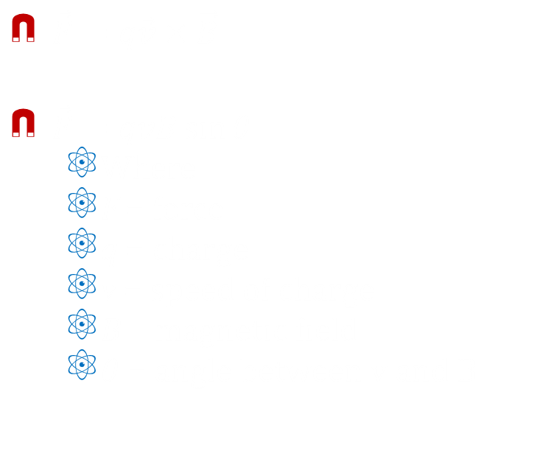
10-02 Magnetic Fields and Force on a Moving Charge
Since currents (moving charges) make B-fields, then other B-fields apply a force to moving charges.
For a moving charge to experience a force
  Charge must be moving
  The velocity vector of the charge must have a component perpendicular to the B-field
$\vec{F}=q\vec{v}×\vec{B}$
$\vec{F}=qvB\sin{θ}$
  Where
  F = force
  q = charge
  v = speed of charge
  B = magnetic field
  $θ$ = angle between v and B

Slide 13
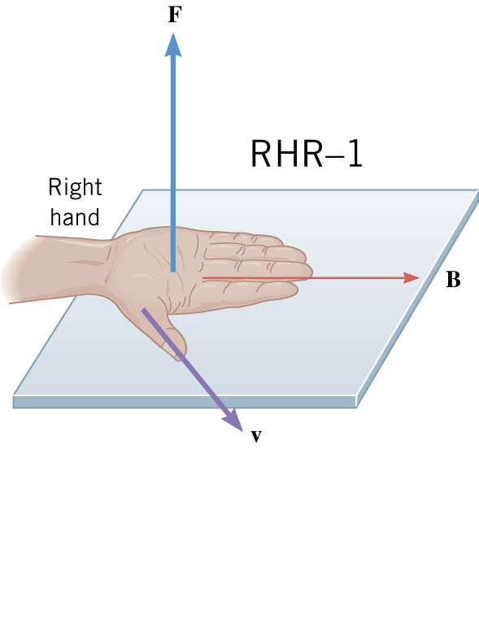
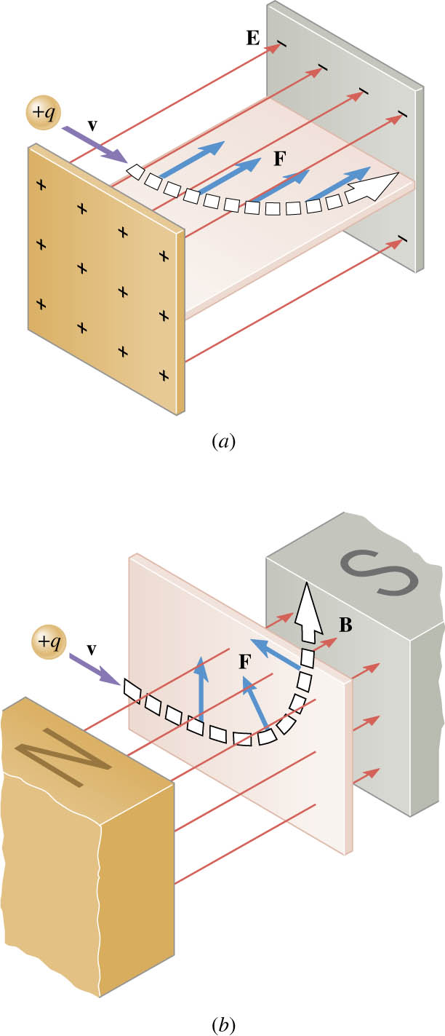
10-02 Magnetic Fields and Force on a Moving Charge
Direction of force on positive moving charge
  Right Hand Rule
    Fingers point in direction of B-field
    Thumb in direction of v
    Palm faces direction of F on positive charge
Force will be zero if v and B are parallel, so a moving charge will be unaffected

Slide 14
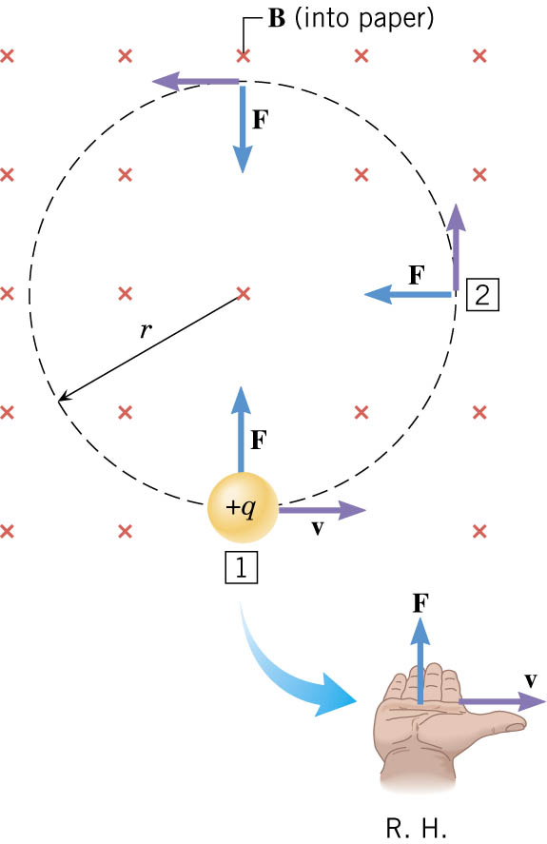

10-02 Magnetic Fields and Force on a Moving Charge
Motion of moving charged particle in uniform B-field
  Circular
  $F=qvB\sin{θ}$
  $F_{C}=\frac{mv^{2}}{r}$
  $qvB\sin{θ}=\frac{mv^{2}}{r}$
  $r=\frac{mv}{qB}$

Slide 15
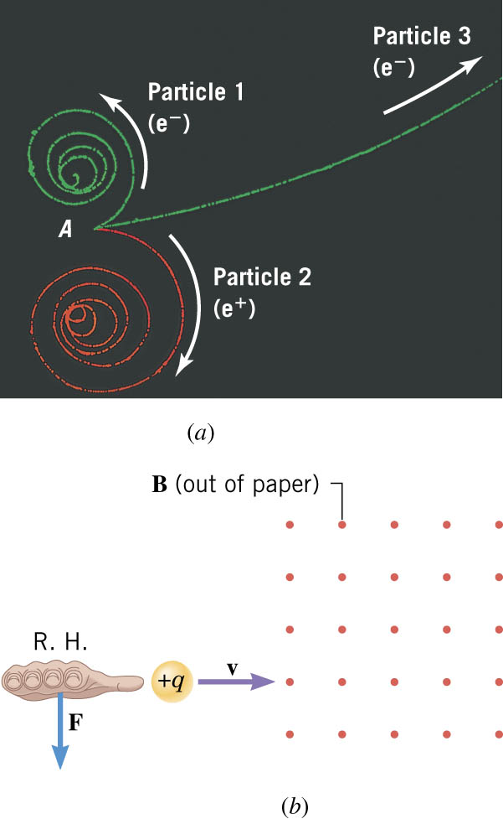
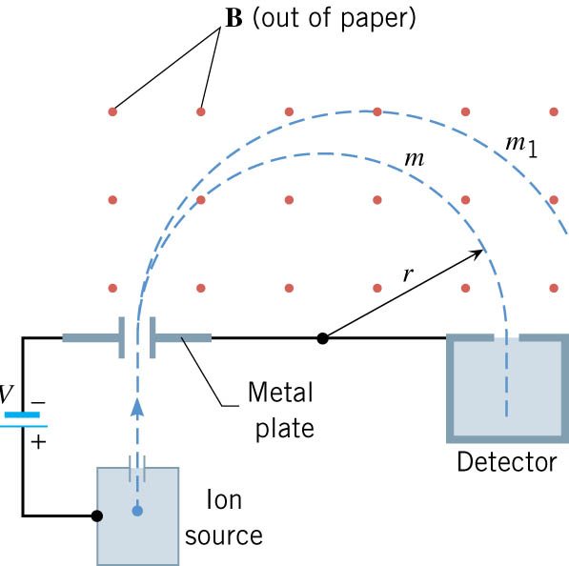
10-02 Magnetic Fields and Force on a Moving Charge
Bubble Chamber
Mass Spectrometer
Notes:
Bubble chamber can be used to determine relative mass to speed and charge ratios of particles.
Mass spectrometer determines relative quantities of various masses in a substance by taking very small particles of the substance and charging them. The charged particles are sent through a uniform magnetic field. The radius of their path tells you their mass.

Slide 16

10-02 Magnetic Fields and Force on a Moving Charge
A particle with a charge of $−1.6×{10}^{−19}$C and mass $9.11×{10}^{−31}$ kg moves along the positive x-axis from left to right. It enters a 3 T B-field is in the x-y plane and points at 45° above the positive x-axis.
  What is the direction of the force on the particle?
    Negative z direction
  After it has been in the B-field, the particle moves in a circle. If the radius of its path is $2×{10}^{−10}$ m, what is the speed of the particle?
    $v = 105.4$m/s
  What is the magnitude of the force on the particle?
    $3.58×{10}^{−17}$ N
Notes:
RHR is for positive charges. Since this is negative it will turn the other way.
$r=\frac{mv}{qB} →2×{10}^{−10} m=\frac{\left(9.11×{10}^{−31} kg\right)v}{\left(1.6×{10}^{−19} C\right)\left(3 T\right)} →9.6×{10}^{−29} CTm=9.11×{10}^{−31} kg\left(v\right) → v=105.4 m/s$
$F=qvB\sin{θ}=\left(1.6×{10}^{−19} C\right)\left(105.4\frac{m}{s}\right)\left(3 T\right)\left(\sin{45°}\right)=3.58×{10}^{−17} N$

Slide 17
10-02 Homework
Force yourself to finish this work
Read 22.7, 22.8

Slide 18
10-03 Magnetic Force on Current-Carrying Wire
In this lesson you will…
• Describe the effects of a magnetic force on a current-carrying conductor.
• Calculate the magnetic force on a current-carrying conductor.
• Describe how motors and meters work in terms of torque on a current loop.
• Calculate the torque on a current-carrying loop in a magnetic field.

Slide 19
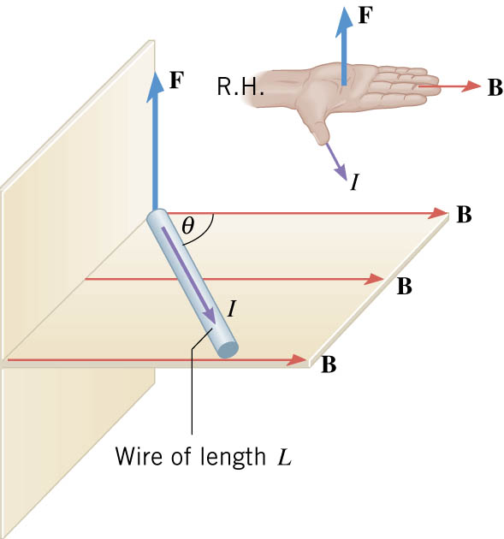

10-03 Magnetic Force on Current-Carrying Wire
Force on a current-carrying wire in B-field
  Direction Follows RHR
  $F=qvB\sin{θ}$
  $F=\frac{q}{t}vtB\sin{θ}$
  $I=\frac{q}{t}$ $L=vt$
  $F=ILB\sin{θ}$

Slide 20
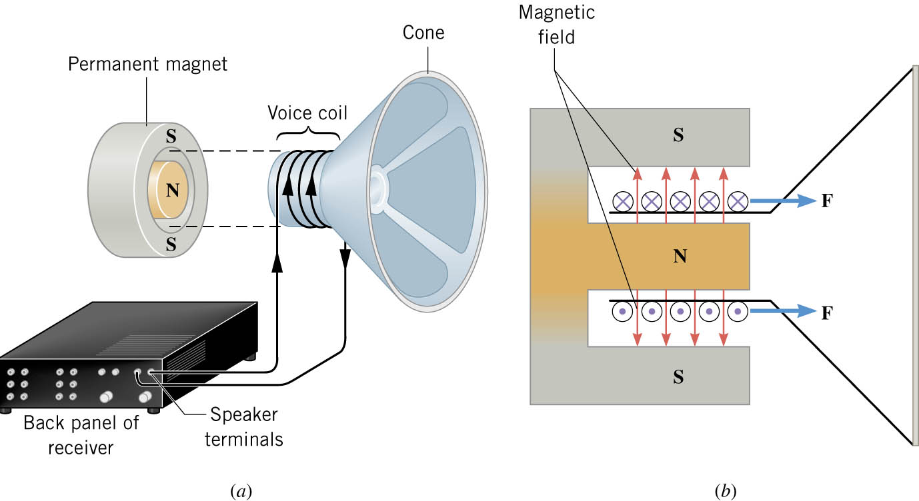
10-03 Magnetic Force on Current-Carrying Wire
Speakers
  Coil of wire attached to cone
  That is enclose by a magnet
  A varying current is run through the wire
  The current in the B-field makes the speaker cone move back and forth

Slide 21
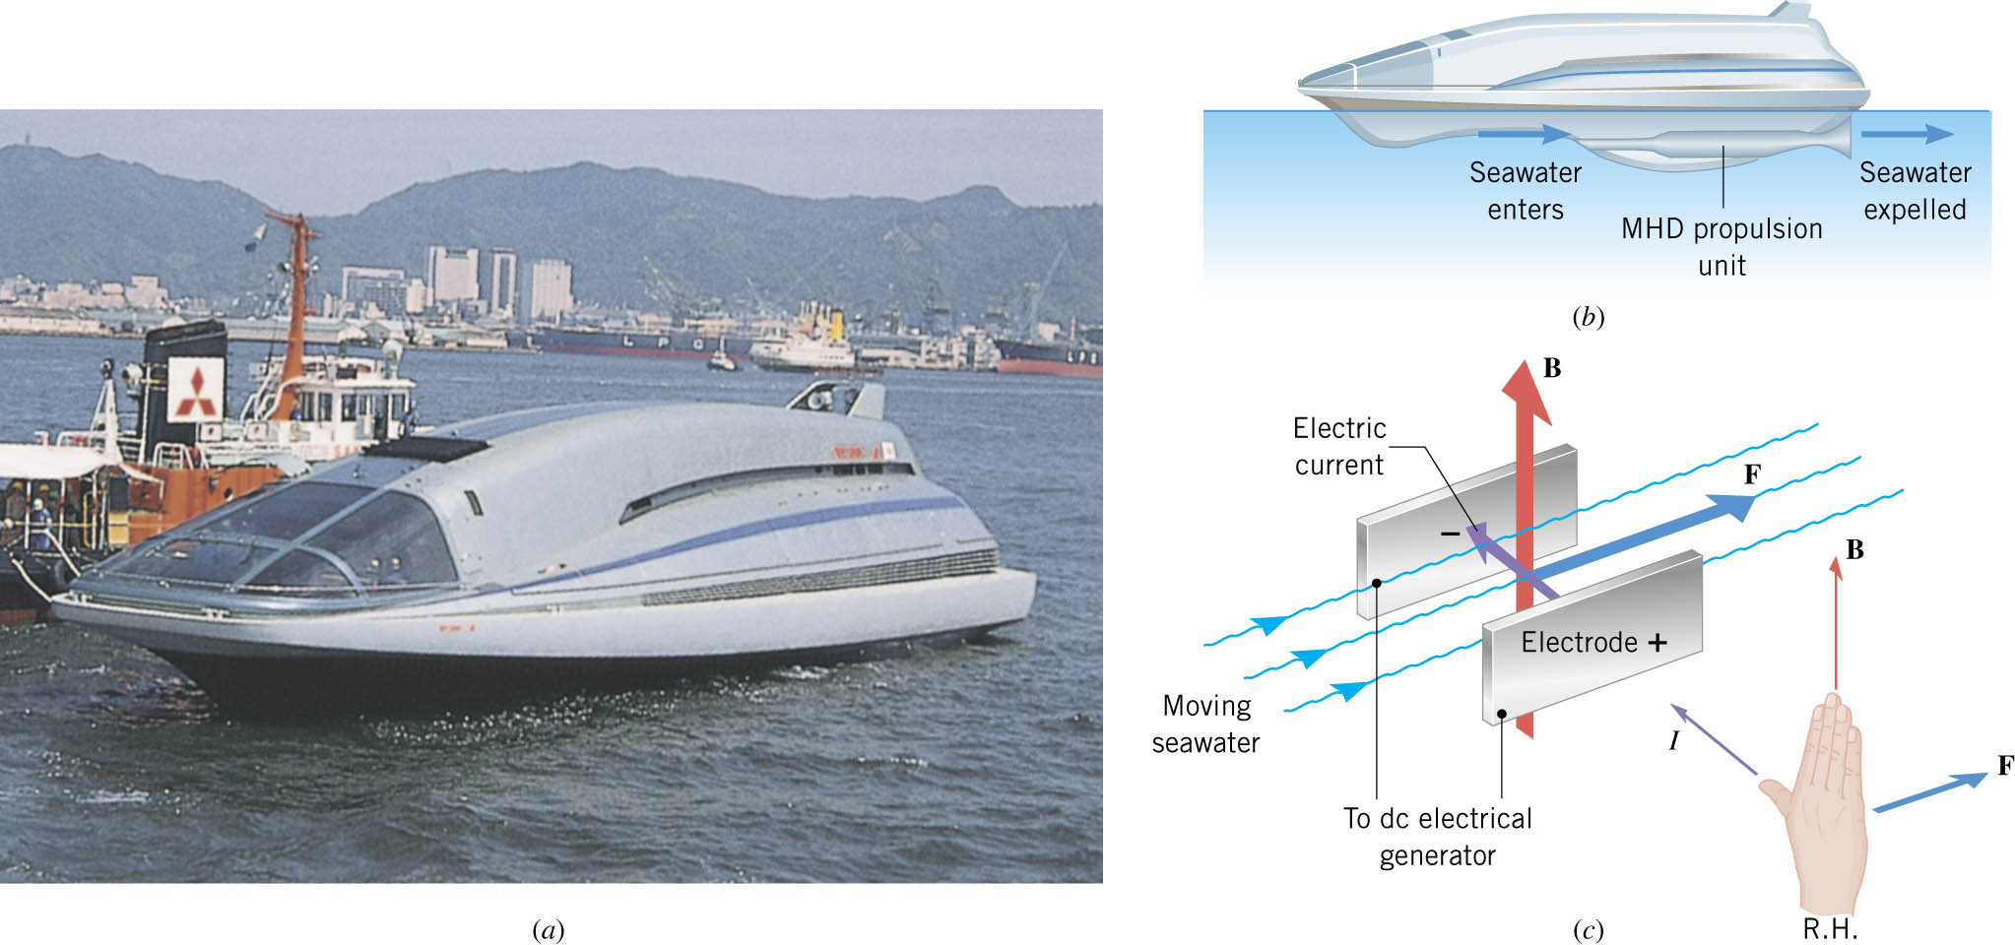
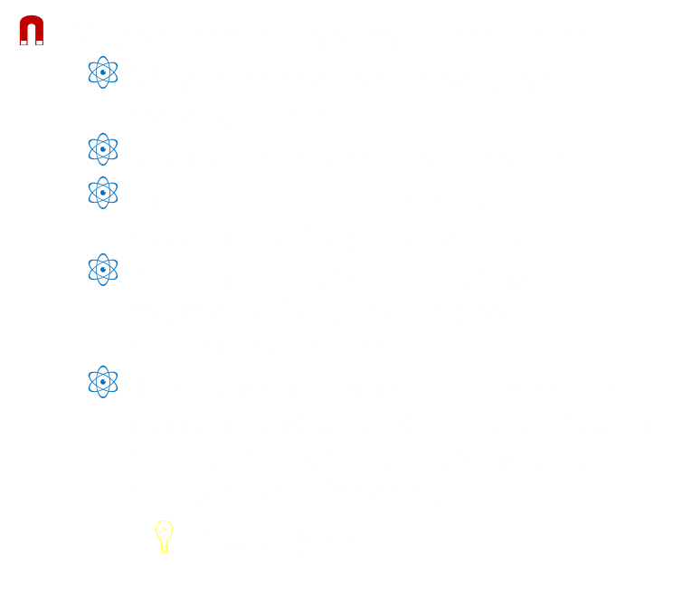
10-03 Magnetic Force on Current-Carrying Wire
Magnetohydrodynamic Propulsion
  Way to propel boats with no moving parts
  Seawater enters tube under ship
  In the tube are electrodes that run current through the water
  Also in the tube is a strong magnetic field created by superconductors
  The interaction with the electric current and B-field push the water out the back of the tube which pushes boat forward
    $F=ILB\sin{θ}$
Notes:
This was the big secret in the movie “Hunt for Red October”
Can also be used to move dangerous chemicals without moving parts (like liquid sodium in large solar collectors)

Slide 22

10-03 Magnetic Force on Current-Carrying Wire
A 2 m wire is in a $2×{10}^{−6}$ T magnetic field pointing into the page. It carries 2 A of current flowing up. What is the force on the wire?
F = $8×{10}^{−6}$ T Left
Notes:
RHR: F points to the left.
$$F=ILB\sin{θ}=\left(2 A\right)\left(2 m\right)\left(2×{10}^{−6} T\right)\left(\sin{90°}\right)=8×{10}^{−6} N$$

Slide 23
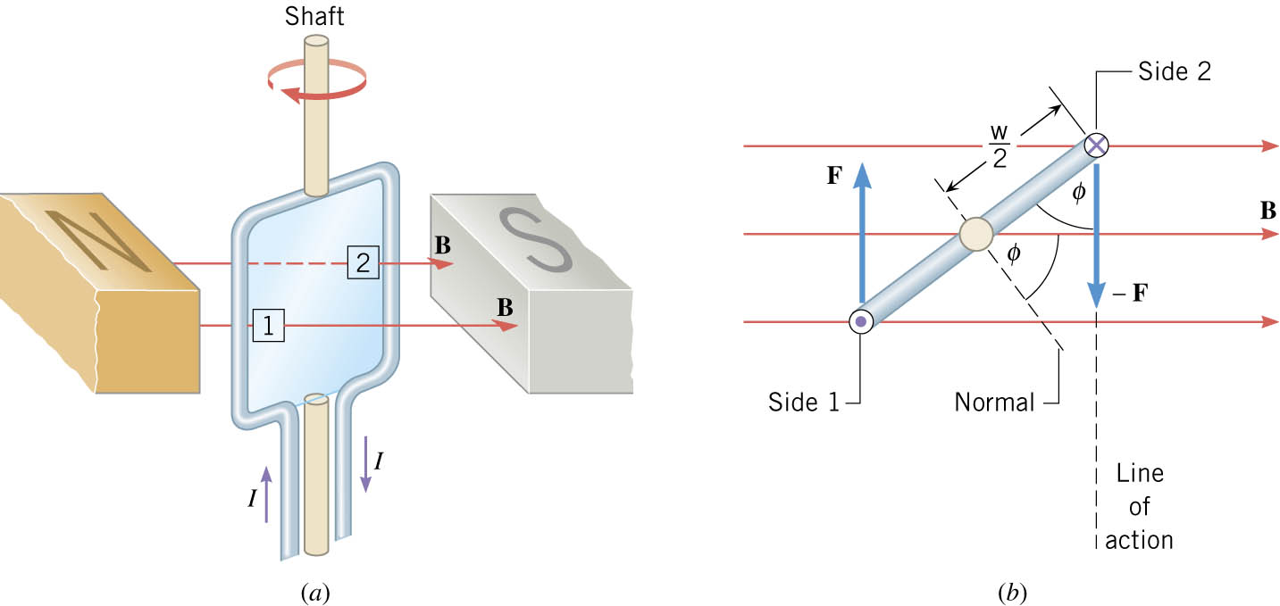
10-03 Magnetic Force on Current-Carrying Wire
What happens when you put a loop of wire in a magnetic field?
Side 1 is forced up and side 2 is forced down (RHR)
This produces a torque
The loop turns until its normal is aligned with the B-field
Notes:
The normal is perpendicular to the plane of the loop

Slide 24

10-03 Magnetic Force on Current-Carrying Wire
Torque on Loop of Wire
  $τ=NIAB\sin{φ}$
where
  N = Number of loops
  I = Current
  A = Area of loop
  B = Magnetic Field
  $φ$ = Angle between normal and B-field
NIA = Magnetic Moment
  Magnetic moment ↑, torque ↑

Slide 25
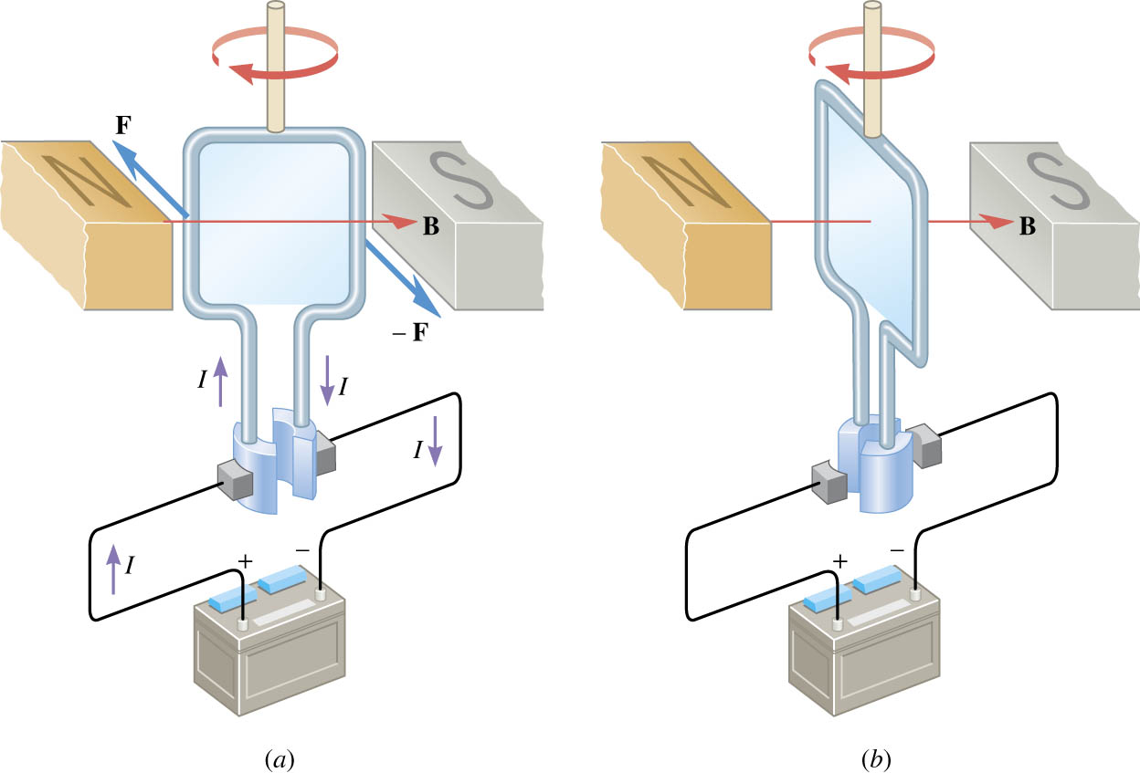
10-03 Magnetic Force on Current-Carrying Wire
Electric Motor
  Many loops of current-carrying wire placed between two magnets (B-field)
  The loops are attached to half-rings
  The torque turns the loops until the normal is aligned to B-field
  At that point the half-rings don’t connect to electric current
  Momentum makes the loop turn more
  The half-rings connect with the current to repeat the process

Slide 26

10-03 Magnetic Force on Current-Carrying Wire
A simple electric motor needs to supply a maximum torque of 10 Nm. It uses 0.1 A of current. The magnetic field in the motor is 0.02 T. If the coil is a circle with radius of 2 cm, how many turns should be in the coil?
N = $3.98×{10}^{6}$ turns
Notes:
$$τ=NIAB\sin{φ}→ 10 Nm=N\left(0.1 A\right)\left(π\left(0.02 m\right)2\right)\left(0.02 T\right)\sin{90°} → 10 Nm=\left(2.513×{10}^{−6} Nm\right)N → N=3.98×{10}^{6}$$

Slide 27
10-03 Homework
Don’t get stuck on these magnet problems
Read 22.9, 22.10, 22.11

Slide 28
10-04 Magnetic Fields Produced by Currents
In this lesson you will…
• Calculate current that produces a magnetic field.
• Use the right hand rule 2 to determine the direction of current or the direction of magnetic field loops.
• Describe the effects of the magnetic force between two conductors.
• Calculate the force between two parallel conductors.
• Describe some applications of magnetism.

Slide 29
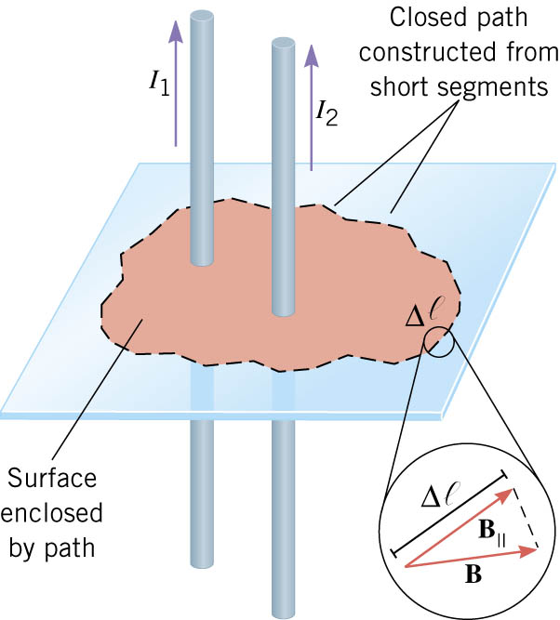

10-04 Magnetic Fields Produced by Currents
Ampere’s Law
$∑\vec{B}⋅Δ\vec{ℓ}=μ_{0}I$
$∑B_{∥}Δℓ=μ_{0}I$
Where
  B = the magnetic field (B|| is the B-field parallel to ℓ)
  Δℓ = a portion of the path surround the current
  μ₀ = permeability of free space = $4π×{10}^{−7}$ Tm/A
  I = current enclosed by path
Notes:
Note that Ampere’s Law is valid for any wire configuration
If B is always parallel to the path, then the sum becomes Bℓ

Slide 30
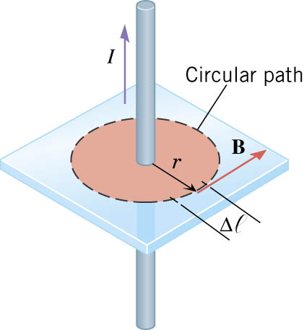
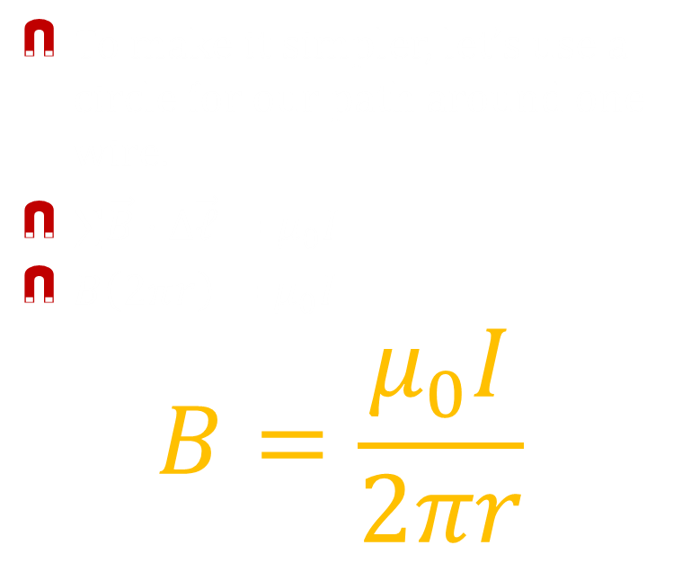
10-04 Magnetic Fields Produced by Currents
To make it simpler, let’s use a circle for our path around one wire.
$∑\vec{B}⋅Δ\vec{ℓ}=μ_{0}I$
$B\left(2πr\right)=μ_{0}I$
$$B=\frac{μ_{0}I}{2πr}$$
Notes:
This agrees with the result from section 7.

Slide 31
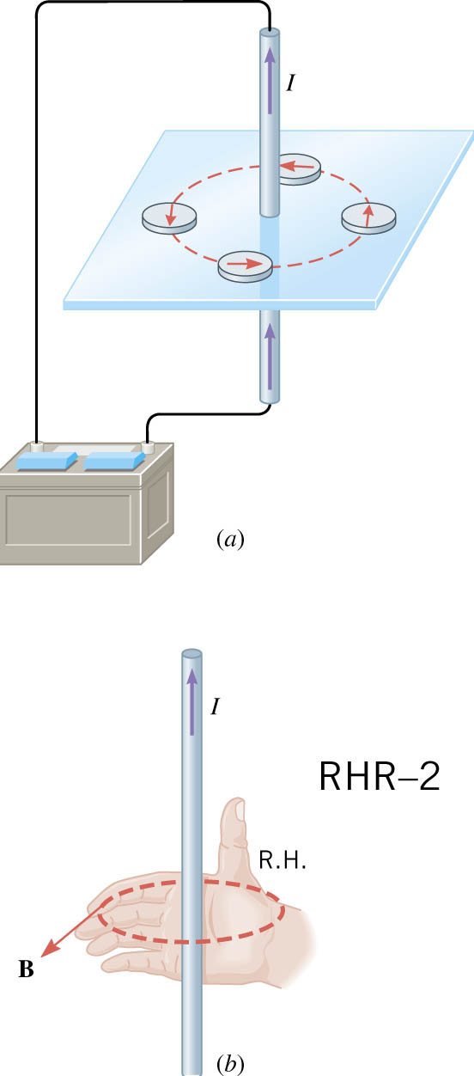
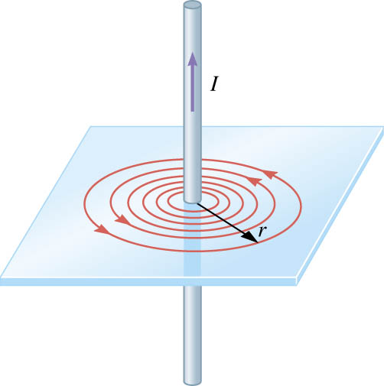

10-04 Magnetic Fields Produced by Currents
Electrical current through a wire
  Straight wire
    Right Hand Rule
      Grab the wire with right hand
      Thumb points in direction of current
      Fingers curl in direction of magnetic field
$$B=\frac{μ_{0}I}{2πr}$$

Slide 32
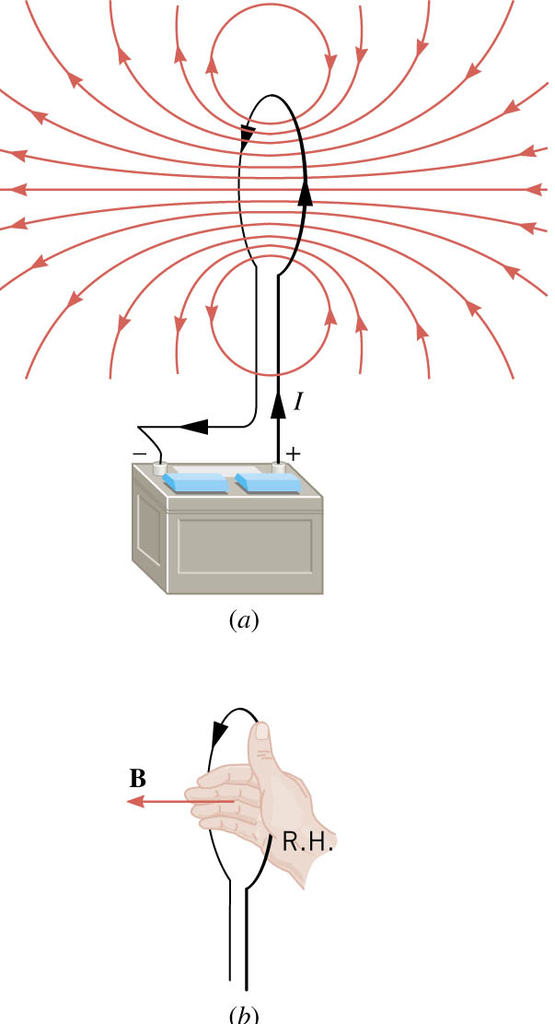
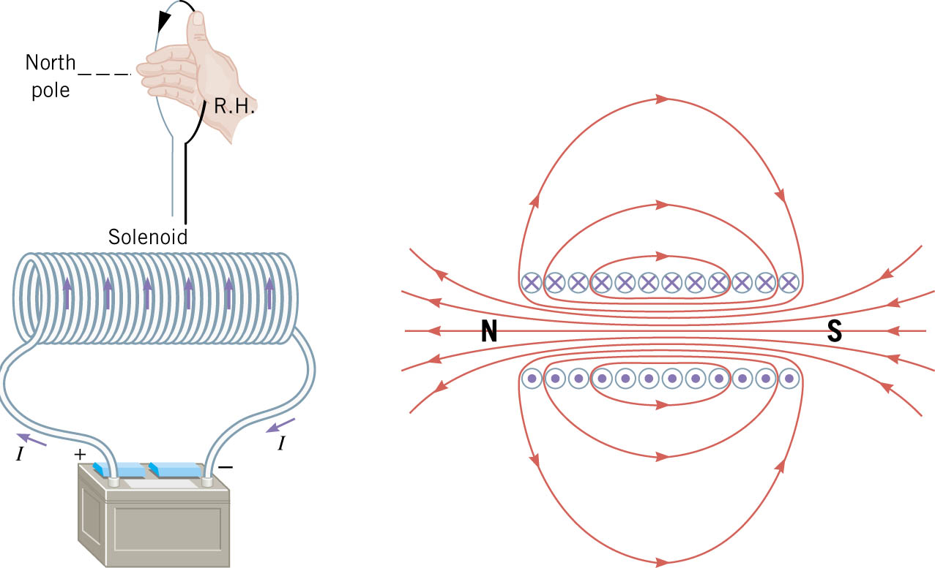
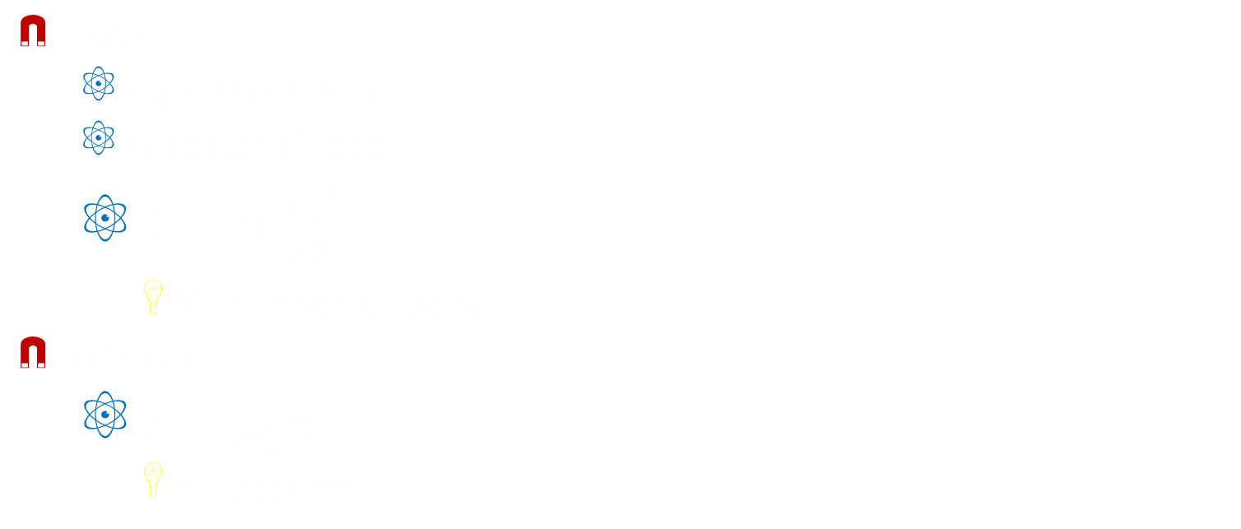
10-04 Magnetic Fields Produced by Currents
Loop
  Right Hand Rule
  At center of loop
  $B=N\frac{μ_{0}I}{2R}$
    N=number of loops
Solenoid
  $B=μ_{0}nI$
    n=loops/m

Slide 33
10-04 Magnetic Fields Produced by Currents
A long straight current-carrying wire runs from north to south.
  A compass needle is placed above the wire points with its N-pole toward the east. In what direction is the current flowing?
  If a compass is put underneath the wire, in which direction will the needle point?
A single straight wire produces a B-field. Another wire is parallel and carries an identical current. If the two currents are in the same direction, how would the magnetic field be affected? What if the currents are in the opposite direction?
Notes:
1a. North (rhr)
1b. West (rhr)
The B-fields between wires cancel; outside of wires add. The B-fields between the wires add; outside of wires cancel.

Slide 34

10-04 Magnetic Fields Produced by Currents
Suppose a piece of coaxial cable is made with a solid wire at the center. A metal cylinder has a common center with the wire and its radius is 1 mm. A 2 A current flows up the center wire and a 1.5 A current flows down the cylinder.
Find the B-field at 4 mm from the center.
  $2.5×{10}^{−5}$ T
Find the B-field at 0.5 mm from the center.
  $8×{10}^{−4}$ T
What current should be in the cylinder to have no B-field outside of the cylinder?
  -2 A
Notes:
$B\left(2πr\right)=μ_{0}I→ B\left(2π0.004 m\right)=4π×{10}^{−7}\frac{Tm}{A}\left(2 A+−1.5 A\right) → B=2×{10}^{−7}\frac{Tm}{A}\frac{0.5 A}{0.004 m}=2.5×{10}^{−5} T$
$B\left(2πr\right)=μ_{0}I→ B\left(2π0.0005 m\right)=4π×{10}^{−7}\frac{Tm}{A} \left(2 A\right) → B=2×{10}^{−7}\frac{Tm}{A}\frac{2 A}{0.0005 m}=8×{10}^{−4} T$
$−2A because 2A + −2A = 0A$

Slide 35

10-04 Magnetic Fields Produced by Currents
Two wires are 0.2 m apart and 2 m long and both carry 2 A of current. What is the force on the wires?
  F = $8×{10}^{−6}$ N towards each other
Force of one wire on another parallel wire
  $\frac{F}{l}=\frac{μ_{0}I_{1}I_{2}}{2πr}$
  Attractive if same I’s in same direction, repulsive if opposite
Notes:
The wires point up.
Find B-field due to the left wire first: B-field points into the page. $B=\frac{μ_{0}I}{2πr} → B=\left(4π×{10}^{−7}\frac{Tm}{A}\right)\frac{2 A}{2π0.2 m}=2×{10}^{−6} T$
Find the force experienced by the right wire due to this B-field: F points to the left. $F=ILB\sin{θ}=\left(2 A\right)\left(2 m\right)\left(2×{10}^{−6} T\right)\left(\sin{90°}\right)=8×{10}^{−6} N$

Slide 36
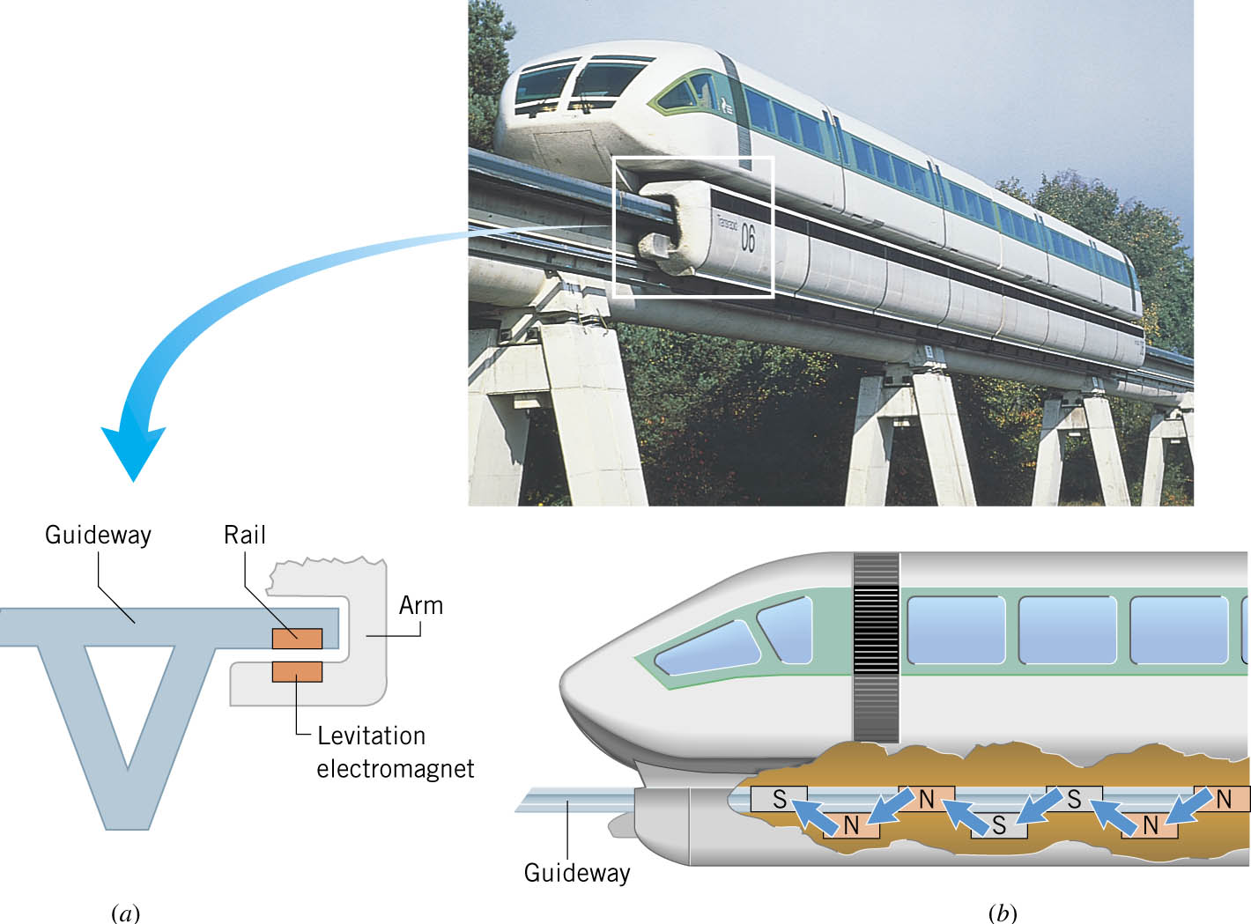
10-04 Magnetic Fields Produced by Currents
Application – Maglev Trains

Slide 37
10-04 Homework
You can field these questions easily.
Read 23.1, 23.2

Slide 38
10-05 Faraday’s Law of Induction and Lenz’s Law
In this lesson you will…
• Calculate the flux of a uniform magnetic field through a loop of arbitrary orientation.
• Describe methods to produce an electromotive force (emf) with a magnetic field or magnet and a loop of wire.
• Calculate emf, current, and magnetic fields using Faraday’s Law.
• Explain the physical results of Lenz’s Law

Slide 39
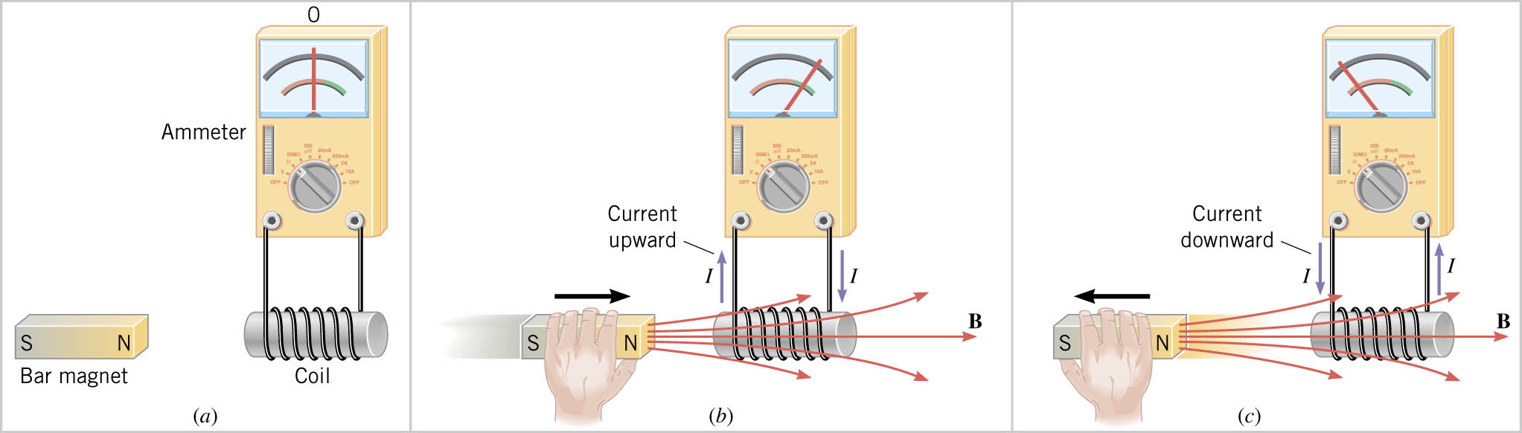
10-05 Faraday’s Law of Induction and Lenz’s Law
Magnetic field can produce current.
The magnetic field must be moving to create current.
The current created is called induced current.
The emf that causes the current is called induced emf.

Slide 40
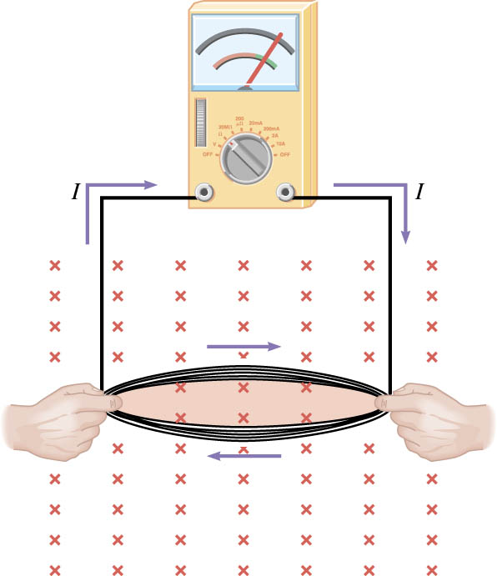
10-05 Faraday’s Law of Induction and Lenz’s Law
Another way to induce emf is by changing the area of a coil of wire in a magnetic field.

Slide 41
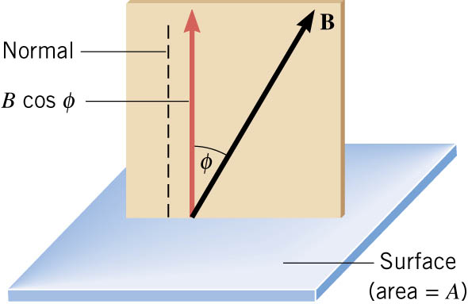
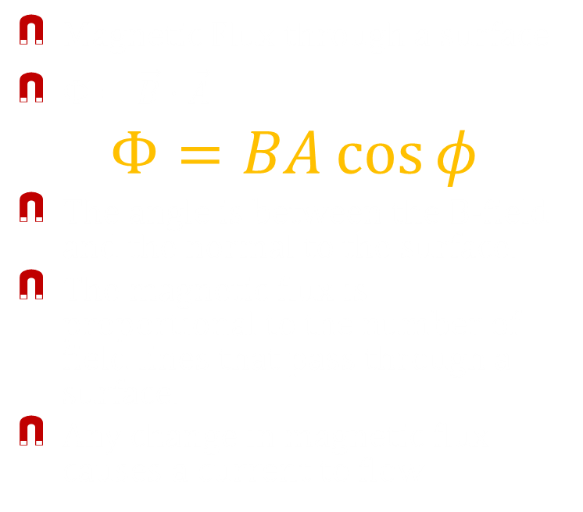
10-05 Faraday’s Law of Induction and Lenz’s Law
Magnetic Flux through a surface
$Φ=\vec{B}⋅\vec{A}$
$$Φ=BA\cos{φ}$$
The angle is between the B-field and the normal to the surface.
The magnetic flux is proportional to the number of field lines that pass through a surface.
Any change in magnetic flux causes a current to flow
Notes:
Dot product found by $BA\cos{θ}$

Slide 42

10-05 Faraday’s Law of Induction and Lenz’s Law
A rectangular coil of wire has a length of 2 cm and a width of 3 cm. It is in a 0.003 T magnetic field. What is the magnetic flux through the coil if the face of the coil is parallel to the B-field lines? What is the flux if the angle between the face of the coil and the magnetic field is 60°?
  0 Wb
  $1.56×{10}^{−6}$ Wb
Notes:
$Φ=BA\cos{φ}$
$Φ=\left(0.003 T\right)\left(0.02 m⋅0.03 m\right)\left(\cos{90°}\right)=0$(no B-field lines pass through the coil)
$Φ=\left(0.003 T\right)\left(0.02 m⋅0.03 m\right)\left(\cos{30°}\right)=1.56×{10}^{−6} Tm^{2} or (Tm^{2}=Wb (weber))$

Slide 43

10-05 Faraday’s Law of Induction and Lenz’s Law
emf is produced when there is a change in magnetic flux through a loop of wire.
No change in flux; no emf.
Experiments (and mathematics) show that $emf=−\frac{ΔΦ}{Δt}$ for a loop of wire
If there are more than one loop, multiply by the number of loops.

Slide 44

10-05 Faraday’s Law of Induction and Lenz’s Law
Faraday’s Law of Electromagnetic Induction
$$emf=−N\left(\frac{Φ−Φ_{0}}{t−t_{0}}\right)=−N\frac{ΔΦ}{Δt}$$
where
  N = number of loops
  Φ = magnetic flux
  t = time
Remember
$$Φ=BA\cos{φ}$$
So changing B, A, or $φ$ will produce a emf
Notes:
Unit of emf is volt (V)

Slide 45

10-05 Faraday’s Law of Induction and Lenz’s Law
A coil of wire (N = 40) carries a current of 2 A and has a radius of 6 cm. The current is decreased at 0.1 A/s. Inside this coil is another coil of wire (N = 10 and r = 3 cm) aligned so that the faces are parallel. What is the average emf induced in the smaller coil during 5 s?
  $1.18×{10}^{−6}$ V
Notes:
Find expression for B-field first
$B=\frac{Nμ_{0}I}{2R} → at t=0 → B=\frac{40⋅4π×{10}^{−7}\frac{Tm}{A}⋅2 A}{2⋅0.06 m}=8.3776×{10}^{−4} T$
$$at t=5 s → B=\frac{40⋅4π×{10}^{−7}\frac{Tm}{A}⋅\left(2−0.5\right) A}{2⋅0.06 m}=6.2832×{10}^{−4} T$$
Find Φ₀ and Φ
$$Φ_{0}=\left(8.3776×{10}^{−4} T\right)\left(π⋅{\left(0.03 m\right)}^{2}\right)\cos{0}=2.369×{10}^{−6} Wb$$
$$Φ=\left(6.2832×{10}^{−4} T\right)\left(π⋅{\left(0.03 m\right)}^{2}\right)\cos{0}=1.777×{10}^{−6} Wb$$
Find emf
$$emf=−N\left(\frac{ΔΦ}{Δt}\right)=−10\left(\frac{1.777×{10}^{−6} Wb−2.369×{10}^{−6} Wb}{5 s}\right)=1.18×{10}^{−6} V$$

Slide 46
10-05 Faraday’s Law of Induction and Lenz’s Law
Lenz’s Law
  The induced emf resulting from a changing magnetic flux has a polarity that leads to an induced current whose direction is such that the induced magnetic field opposes the original flux change.
Reasoning Strategy
  Determine whether the magnetic flux is increasing or decreasing.
  Find what direction the induced magnetic field must be to oppose the change in flux by adding or subtracting from the original field.
  Having found the direction of the magnetic field, use the right-hand rule to find the direction of the induced current.
Notes:
Demonstration: copper tube with falling magnet – the B-field, and thus flux, changes as the magnet gets closer to a section of tube. As the magnet gets closer the flux increases. The induced current then produces a current that makes a B-field opposite the B-field of the magnet. The opposing fields supply an upwards force on the magnet and it falls slowly.

Slide 47
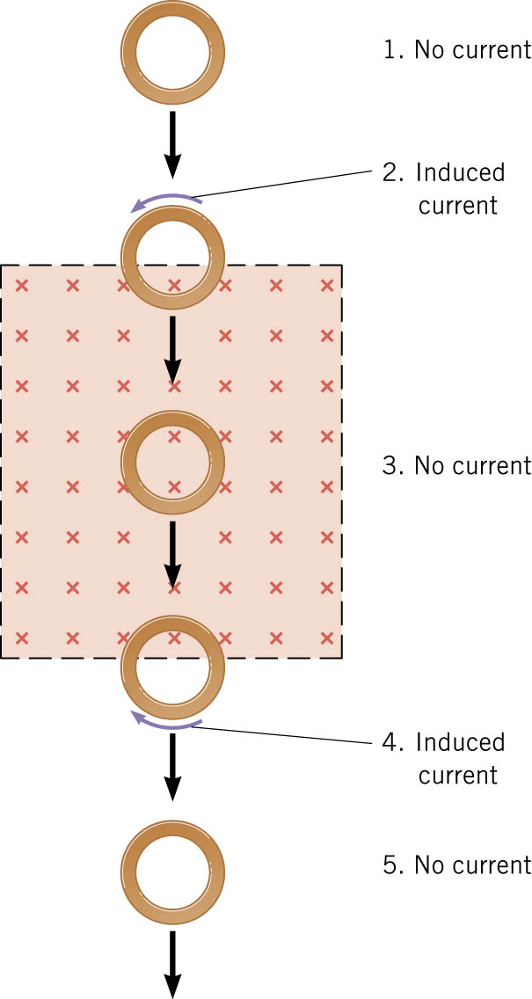
10-05 Faraday’s Law of Induction and Lenz’s Law
A copper ring falls through a rectangular region of a magnetic field as illustrated. What is the direction of the induced current at each of the five positions?
Notes:
0 A, No B-field so no current
Counterclockwise, flux is increasing since the area of the B-field in the loop is increasing. Induced B-field must oppose (out of paper), RHR says current is counterclockwise.
No current because no change in B-field, area, or angle
Clockwise; Flux is decreasing because the area of the B-field in loop is decreasing. Induced B-field must add to the field already there. RHR says current is clockwise.
No current because no B-field.

Slide 48
10-05 Homework
Follow the Laws
Read 23.3, 23.4

Slide 49
10-06 Motional emf and Magnetic Damping
In this lesson you will…
• Calculate emf, force, magnetic field, and work due to the motion of an object in a magnetic field.
• Explain the magnitude and direction of an induced eddy current, and the effect this will have on the object it is induced in.
• Describe several applications of magnetic damping.

Slide 50

10-06 Motional emf and Magnetic Damping
Another way to produce a induced emf is by moving a conducting rod through a constant magnetic field.
Each charge in rod is moving through the magnetic field with velocity, v.
So, each charge experiences a magnetic force.
$$F=qvB\sin{θ}$$
Since the electrons can move they are forced to one end of the rod leaving positive charges at the other end.
If there was a wire connecting the ends of the rod, the electrons would flow through the wire to get back to the positive charges.
Notes:
This is called motional emf because it is from motion

Slide 51

10-06 Motional emf and Magnetic Damping
This is called motional emf ($ℰ$)
If the rod did not have the wire, the electrons would move until the attractive electrical force is balanced with the magnetic force.
$$Eq=qvB\sin{θ}$$
$$Eq=qvB$$
$$\frac{emf}{L}q=qvB$$
$$emf=vBL$$
Notes:
v, B, and L must be all perpendicular to each other

Slide 52
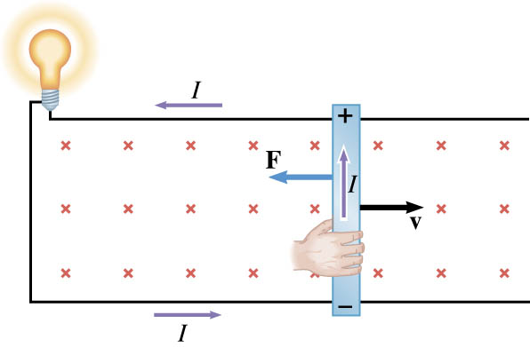
10-06 Motional emf and Magnetic Damping
It takes a force to move the rod.
Once the electrons are moving in the rod, there is another force. The moving electrons in a B-field create a magnetic force on the rod itself.
According to the RHR, the force is opposite the motion of the rod. If there were no force pushing the rod, it would stop.
Notes:
If the force went with the motion of the rod, then it would accelerate without bound.

Slide 53
10-06 Motional emf and Magnetic Damping
Damping
  When a conductor moves into (or out of) a magnetic field, an eddy current is created in the conductor
  As the conductor moves into B-field, the flux increases
  This produces a current by Faraday’s Law and is directed in way that opposes change in flux.
  This current’s B-field causes a force on the conductor
  The direction of the force will be opposite the motion of the conductor

Slide 54
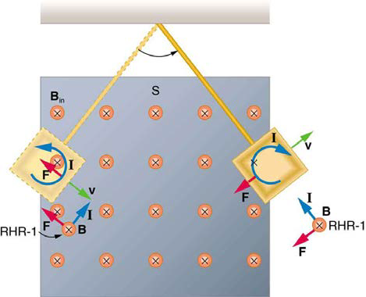
10-06 Motional emf and Magnetic Damping

Slide 55
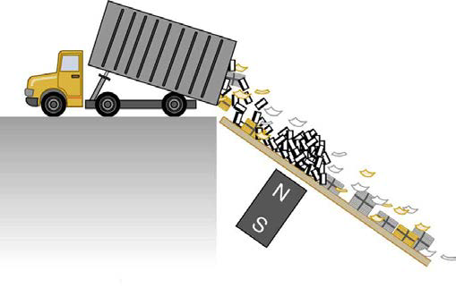
10-06 Motional emf and Magnetic Damping
Applications of Magnetic Damping
  Stopping a balance from moving
  Brakes on trains/rollercoasters
    No actual sliding parts, not effected by rain, smoother
    Since based on speed, need conventional brakes to finish
  Sorting recyclables
    Metallic objects move slower down ramp

Slide 56
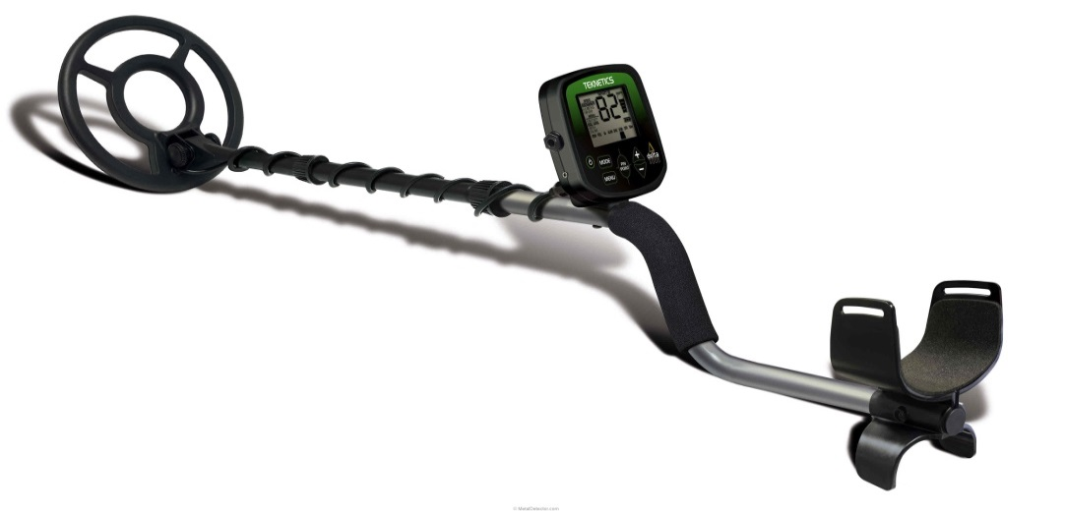
10-06 Motional emf and Magnetic Damping
Metal Detectors
  Primary coil has AC current
  This induces current in metal
  The induced current creates a B-field
  This induced B-field creates current in secondary coil which sends signal to user

Slide 57
10-06 Homework
Don’t let the homework dampen your spirits
Read 23.5, 23.6

Slide 58
10-07 Electric Generators and Back Emf
In this lesson you will…
• Calculate the emf induced in a generator.
• Calculate the peak emf which can be induced in a particular generator system.
• Explain what back emf is and how it is induced.

Slide 59
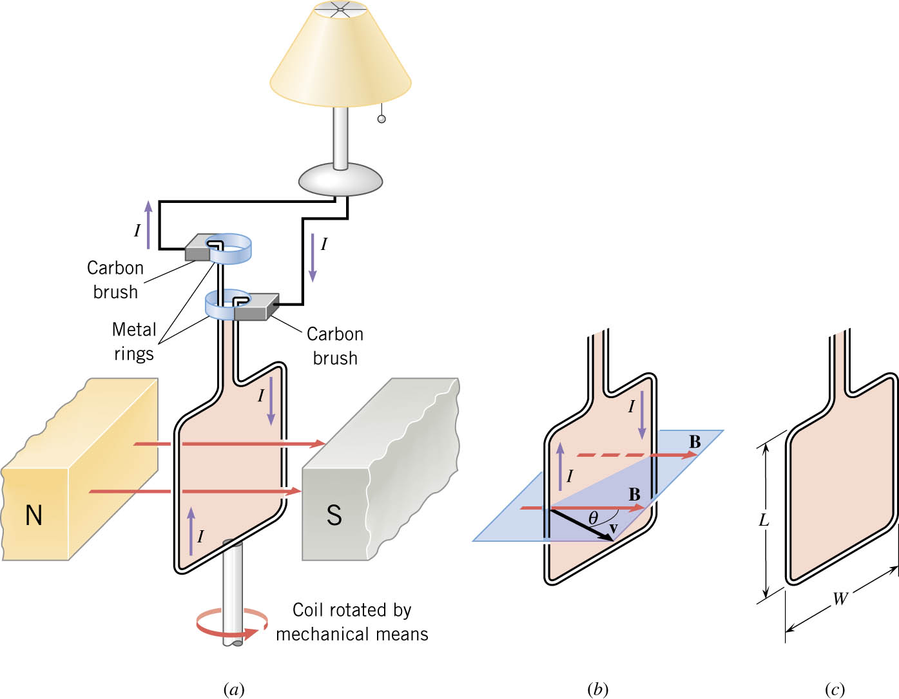
10-07 Electric Generators and Back Emf
A loop of wire is rotated in a magnetic field.
Since the angle between the loop and the B-field is changing, the flux is changing.
Since the magnetic flux is changing an emf is induced.

Slide 60

10-07 Electric Generators and Back Emf
For a conducting rod moving in B-field
$$emf=vBL\sin{θ}$$
Two rods for each loop so
$$emf=2NvBL\sin{θ}$$
Often want in terms of angular velocity instead of tangential velocity
$$θ=ωt$$
$$emf=2NvBL\sin{ωt}$$
Notes:
Angular velocity is how many radians (angles) it turns through in a given time.
Tangential velocity is how fast the rod is going in a straight line.

Slide 61

10-07 Electric Generators and Back Emf
The vertical sides turn in circle with radius W/2.
Tangential speed of each side
$$v=rω=\frac{W}{2}ω$$
$$emf=2N\frac{W}{2}ωBL\sin{ωt}$$
Area is LW so
Notes:
Angular velocity is how many radians (angles) it turns through in a given time.
Tangential velocity is how fast the rod is going in a straight line.

Slide 62
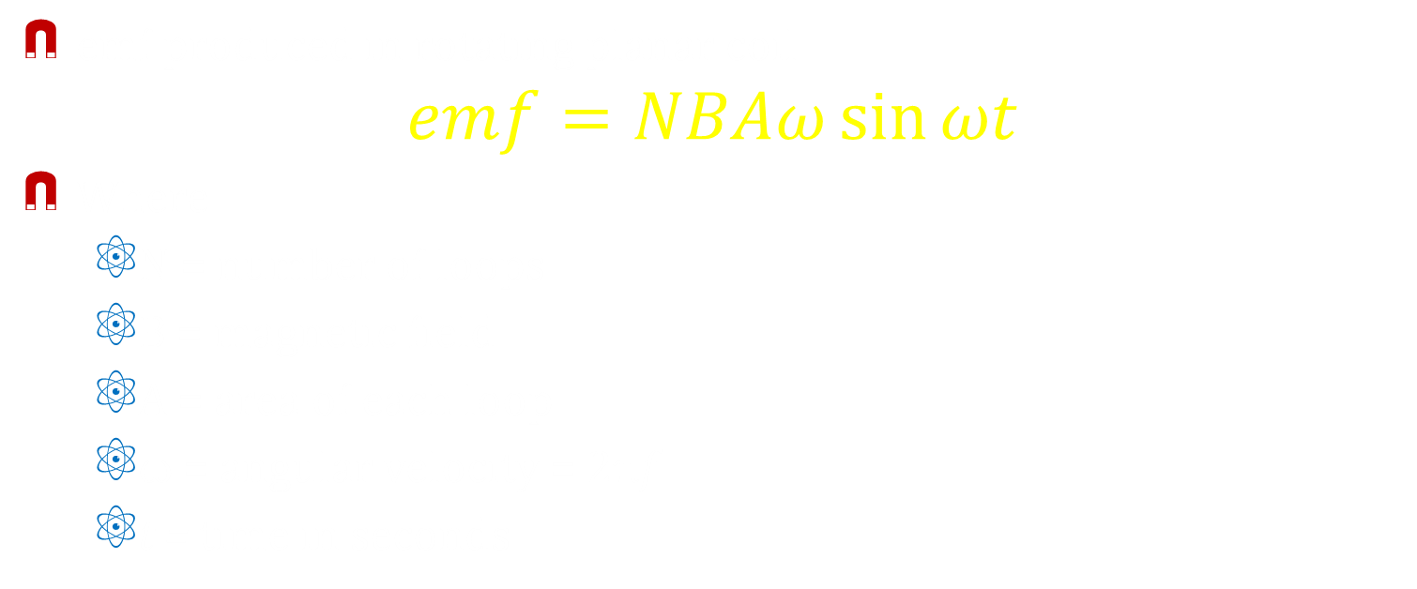
10-07 Electric Generators and Back Emf
emf produced in rotating planar coil
$$emf=NBAω\sin{ωt}$$
Where
  N = number of loops
  B = magnetic field
  A = area of each loop
  ω = angular velocity = 2πf
  t = time in seconds
Notes:
f is the frequency

Slide 63
10-07 Electric Generators and Back Emf
According to Lenz’s Law, the current will flow the one direction when the angle is increasing and it will flow the opposite direction when the angle is decreasing.
These generators often called alternating current generators.

Slide 64
10-07 Electric Generators and Back Emf
You have made a simple generator to power a TV. The armature is attached the rear axle of a stationary bike. For every time you peddle, the rear axel turns 10 times. Your TV needs a V_{rms} of 110V to operate. If the B-field is 0.2 T, each loop is a circle with r = 3 cm, and you can comfortably peddle 3 times a second; how many loops must you have in your generator so that you can watch TV while you exercise?
  1460 loops
Notes:
Needed emf: $emf_{rms}=\frac{emf}{\sqrt{2}} → 110 V=\frac{emf}{\sqrt{2}} → emf=155.6 V peak$
Peak emf occurs when $\sin{ωt}=1$
$$emf_{peak}=NAB\left(2πf\right)→ 155.6 V=N\left(π{\left(0.03 m\right)}^{2}\right)\left(0.2 T\right)\left(2π3⋅10 Hz\right)→ 155.6 V=N\left(0.1066 V\right) → N=1460 loops$$

Slide 65

10-07 Electric Generators and Back Emf
Back emf
  When a coil is turned in a B-field an emf is produced
  If an electric motor is running, its coil is turning in a B-field
  By Lenz’s Law, this emf will oppose the emf used to turn the motor (called back emf)
  It will reduce the voltage across the motor and cause it to draw less current ($V=IR$)
  The back emf is proportional to the speed, so when motor starts it draws max I, but as it speeds up the I decreases

Slide 66
10-07 Homework
Please generate plenty of answers
Read 23.7, 23.8

Slide 67
10-08 Transformers and Electrical Safety
In this lesson you will…
• Explain how a transformer works.
• Calculate voltage, current, and/or number of turns given the other quantities.
• Explain how various modern safety features in electric circuits work, with an emphasis on how induction is employed.

Slide 68
10-08 Transformers and Electrical Safety
The voltage in a wall outlet is approximately 110V.
Many electrical appliances can’t handle that many volts.
  Computer speakers 9V
  Projection TV 15000V
A transformer changes the voltage for the appliance.

Slide 69
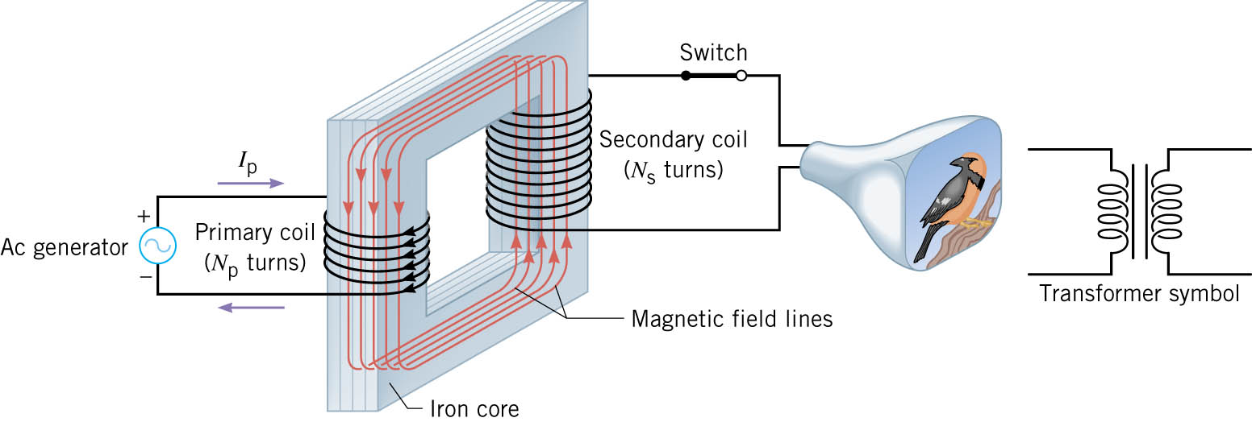
10-08 Transformers and Electrical Safety
The primary coil creates a magnetic field in the iron core.
Since the current in the coil is AC, the B-field is always changing.
The iron makes the B-field go through the secondary coil.
The changing B-field means the flux in the secondary coil is also changing and thus induces a emf.

Slide 70

10-08 Transformers and Electrical Safety
Induced emf
$$emf_{S}=−N_{S}\frac{ΔΦ}{Δt}$$
Primary emf
$$emf_{P}=−N_{P}\frac{ΔΦ}{Δt}$$
Dividing
$$\frac{emf_{S}}{emf_{P}}=\frac{N_{S}}{N_{P}}$$
Transformer equation
$$\frac{V_{S}}{V_{P}}=\frac{N_{S}}{N_{P}}$$
But $P=IV$
  Next slide please…

Slide 71
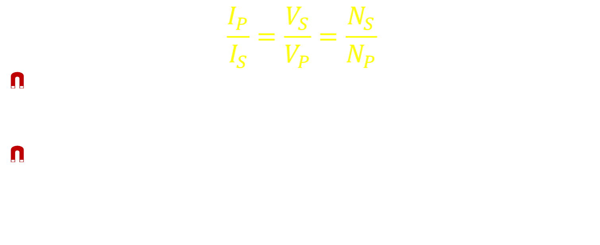
10-08 Transformers and Electrical Safety
$$\frac{I_{P}}{I_{S}}=\frac{V_{S}}{V_{P}}=\frac{N_{S}}{N_{P}}$$
A transformer that steps up the voltage, steps down the current and vise versa.
To keep electrical lines from getting hot, electrical companies use transformers to step up the voltage to up to 11000V. The box on electrical pole is a transformer that steps the voltage down to 220V.
Notes:
Point out that a transformer that steps up the voltage, steps down the current.
A transformer that steps down the voltage, steps up the current.

Slide 72
10-08 Transformers and Electrical Safety
A TV requires 15000V and 0.01 A to accelerate the electron beam. The outlet in the house supplies 120V. The primary coil of the transformer in the TV has 100 turns. How many turns should the secondary coil have?
  12500 turns
How much current does the TV draw from the outlet?
  1.25 A
Notes:
$$\frac{V_{S}}{V_{P}}=\frac{N_{S}}{N_{P}}→\frac{15000 V}{120 V}=\frac{N_{S}}{100}→12500 turns$$
$$\frac{I_{P}}{I_{S}}=\frac{V_{S}}{V_{P}}→\frac{I}{0.01 A}=\frac{15000 V}{120 V}→1.25 A$$

Slide 73
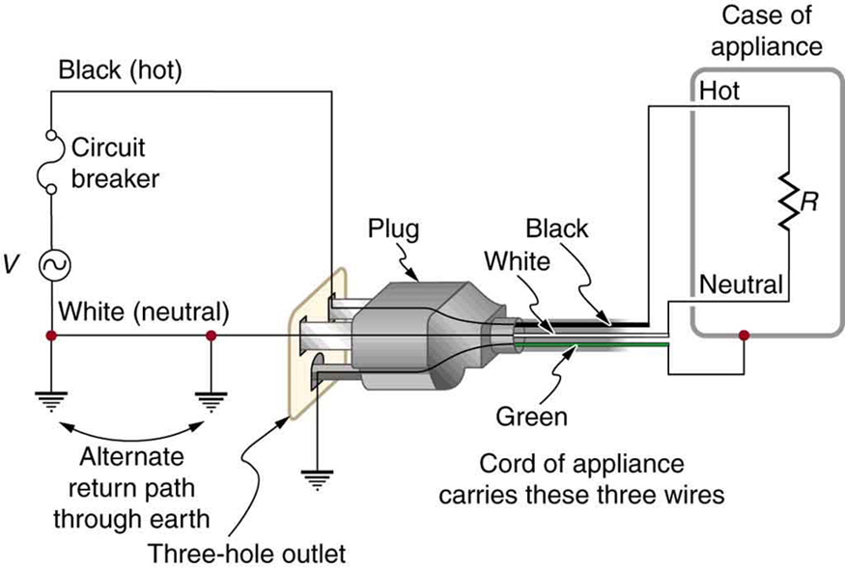
10-08 Transformers and Electrical Safety
Safety
  Two grounds
    White wire
      Wide prong
      Return through ground
    Green wire
      3rd prong
      Grounds the case
  Hot wire
    Black/red
      Carries the higher voltage

Slide 74
10-08 Transformers and Electrical Safety
Circuit Breaker
  If the current load gets too large, an electromagnet pulls a switch to stop the current
  Stops wires from getting hot in short circuits

Slide 75
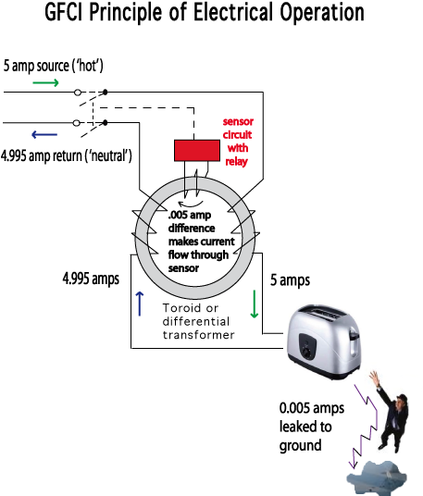
10-08 Transformers and Electrical Safety
Ground Fault Interrupter
  Both sides (hot and neutral) are wrapped around a metal toroid like a transformer, but the number of loops are equal
  Normally the induced current is 0 since the two sides cancel
  If an imbalance occurs (like current going through a person to the ground), an electromagnet pulls a switch

Slide 76
10-08 Homework
Please transform the questions into answers
Read 23.9

Slide 77
10-09 Inductance
In this lesson you will…
• Calculate the inductance of an inductor.
• Calculate the energy stored in an inductor.
• Calculate the emf generated in an inductor.

Slide 78
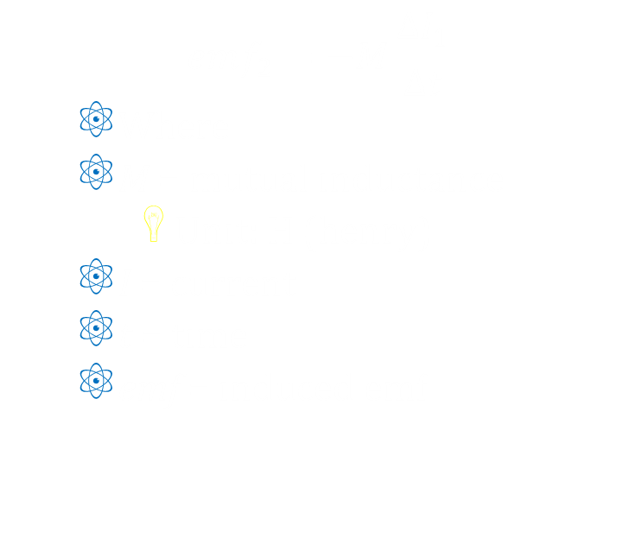
10-09 Inductance
Induction is process where emf is induced by changing magnetic flux
Mutual inductance is inductance of one device to another like a transformer
Change in flux usually by changing current since they are solid pieces
Can be reduced by counterwinding coils
$$emf_{2}=−M\frac{ΔI_{1}}{Δt}$$
  Where
  M = mutual inductance
    Unit: H (henry)
  I = current
  t = time
  emf = induced emf

Slide 79

10-09 Inductance
Self-inductance
  A changing current in a coil causes a changing B-field in middle of coil
  Changing B-field causes induced emf in the same coil
  Resists change in current in the device
$$emf=−L\frac{ΔI}{Δt}$$
L = self-inductance
  Unit: H (henry)

Slide 80
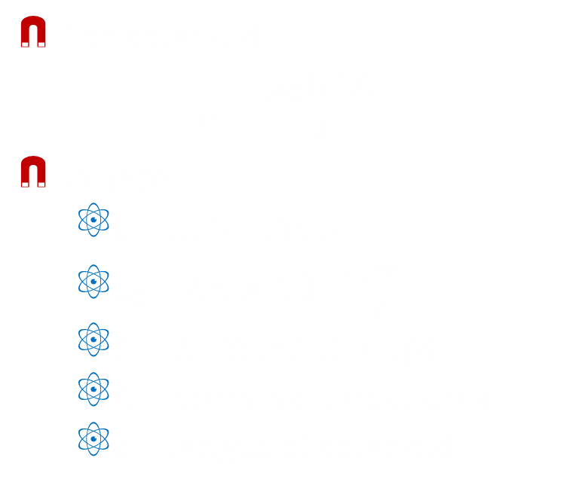
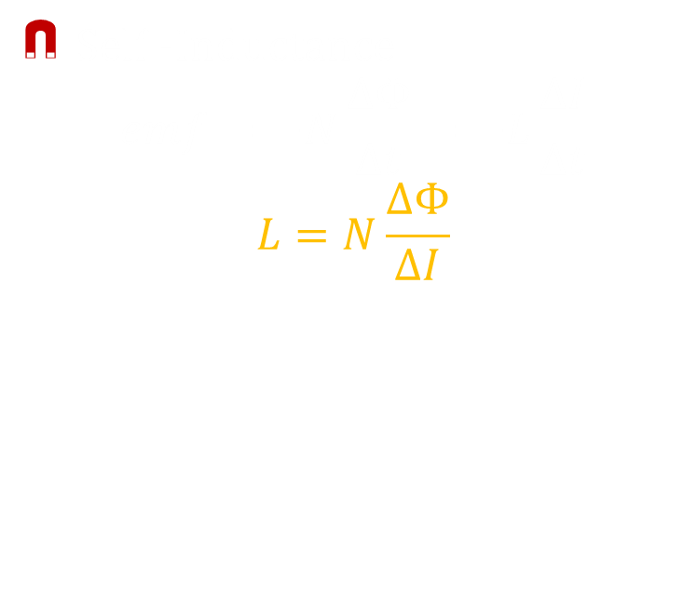
10-09 Inductance
Self -Inductance
$$emf=−N\frac{ΔΦ}{Δt}=−L\frac{ΔI}{Δt}$$
$$L=N\frac{ΔΦ}{ΔI}$$
For solenoid
$$L=\frac{μ_{0}N^{2}A}{ℓ}$$
Where
  L = inductance
  $μ_{0}$ = $4π×{10}^{−7}\frac{Tm}{A}$
  N = number of loops
  A = cross-sectional area
  $ℓ$ = length of solenoid

Slide 81
10-09 Inductance
The 4.00 A current through a 7.50 mH inductor is switched off in 8.33 ms. What is the emf induced opposing this?
3.60 V
Notes:
$$emf=−L\frac{ΔI}{Δt}$$
$$emf=−\left(7.50×{10}^{−3} H\right)\frac{0 A−4.00 A}{8.33×{10}^{−3} s}=3.60 V$$

Slide 82

10-09 Inductance
Energy stored in an inductor
$$E_{ind}=\frac{1}{2}LI^{2}$$
Where
  $E_{ind}$ = energy
  L = inductance
  I = current

Slide 83
10-09 Homework
Let me induce you to finish up this unit by solving these problems

